Slide 1

GRP NO-8
DOMAIN-ML

Slide 2
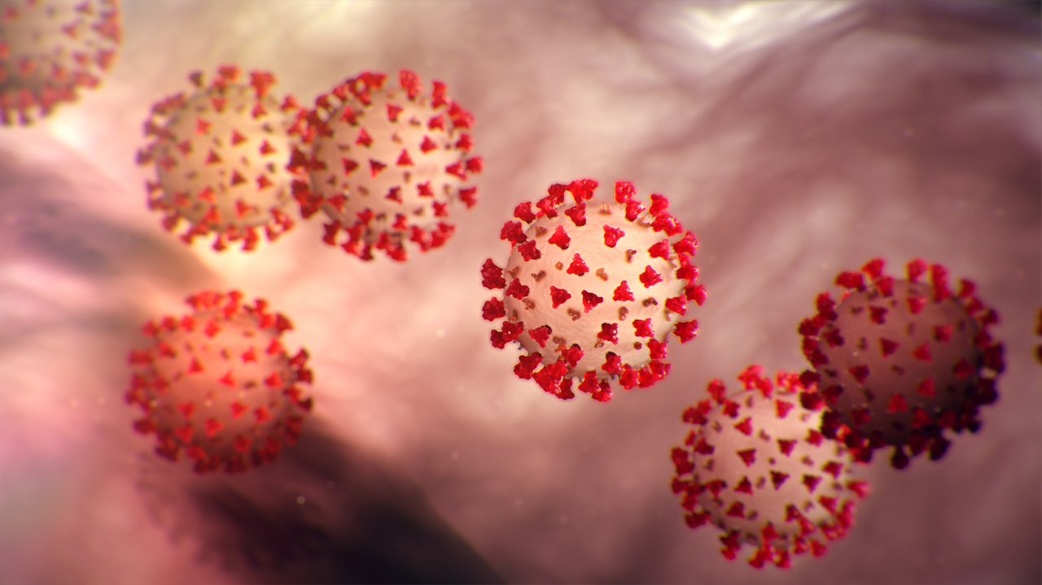
COVID ANALYSIS
Date: 8-12-21 TO 24-12-21
Name: AFREEN FATIMA
Course Code:

Slide 3

Topic covering in ppt
Problem Statement
Technology used
Dataset
Micro Task (1-4)
Steps to solve the problem
Outputs

Slide 4

Problem Statement
TASK : predict the increase in day to day
case in covid
Covid analysis using python .
Techonology used:
Jupyter notebook (python 3.8)

Slide 5
Dataset
Data set of covid19 taken from widhya.org
In the Data set : following Details are given
Date, State/UnionTerritory, ConfirmedIndianNational,
ConfirmedForeignNational, Cured, Deaths

Slide 6
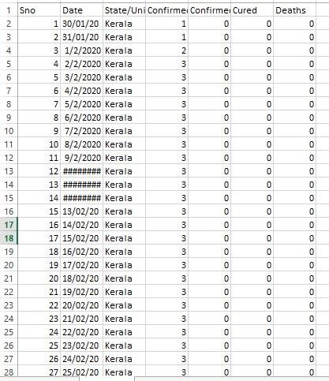
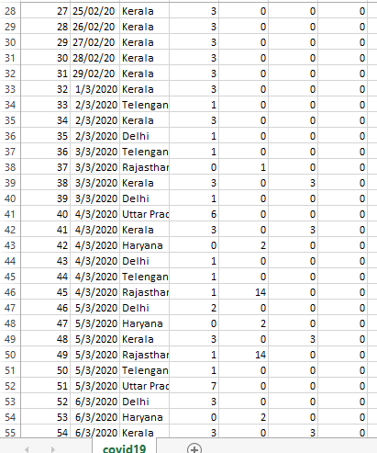
COVID 19 DATA SET

Slide 7
Function imported to solve the problem
import pandas as pd
import numpy as np
import matplotlib.pyplot as plt

Slide 8
Micro task given by WIDHYA .ORG
4 task were given in
Task 1 – Modeling approach taken to model a pandemic-proportionate
Task 2- Mathematical function we use to model the spread of pandemic-Exponential

Slide 9
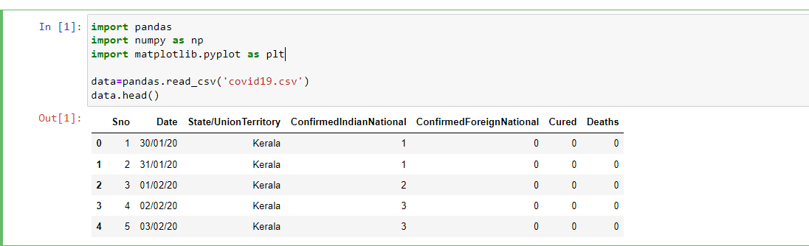
Steps to Solve problem
Save the covid19.csv file in same folder of jupyter notebook file
Read the data from covid19.csv using code

Slide 10
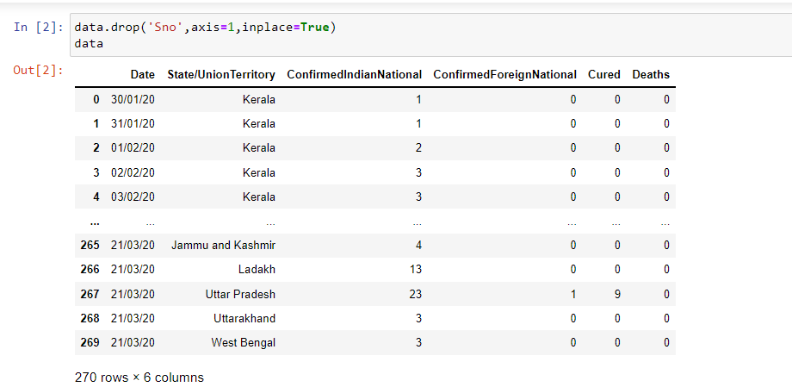

Slide 11
MICRO TASK-3
3. Group the data rows by dates to get daily cases count by using Groupby function in pandas .Sort argument to false.
4. Store the new dataframe in new variable.

Slide 12
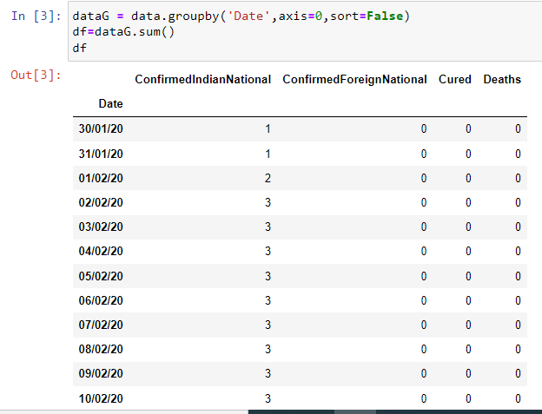
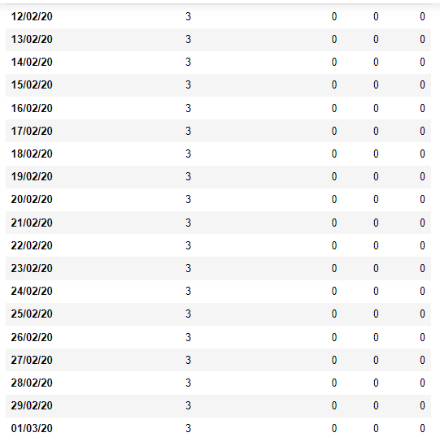
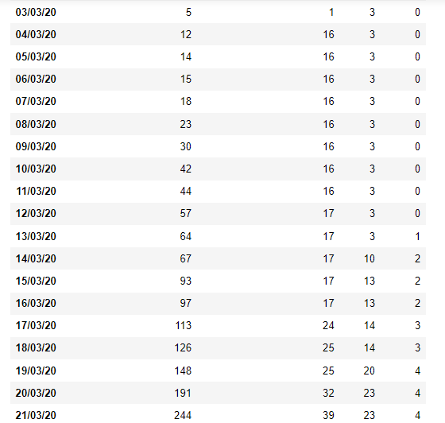

Slide 13
MICRO TASK-3
5. Aim –To see the daily trend of covid cases.
Sum up each cell in each row and store the result in the dataframe as a new variable.
Sum function gives sum of elements column wise not row wise

Slide 14
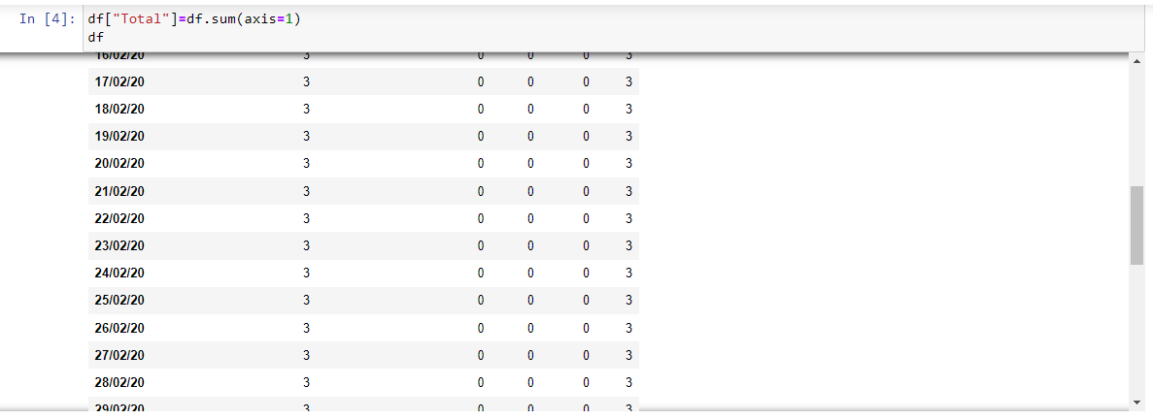
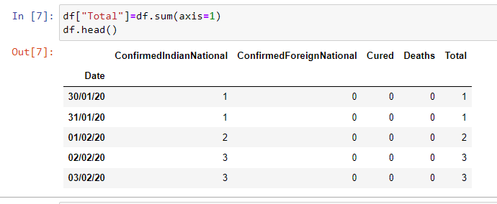

Slide 15
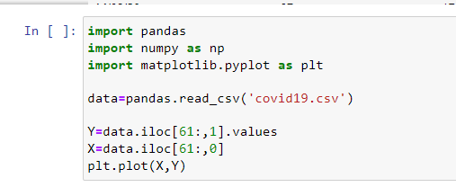
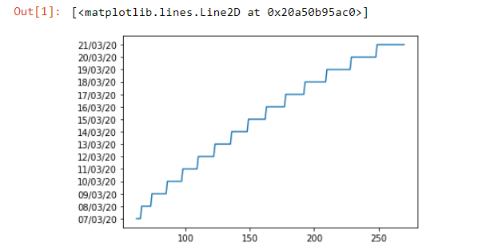
MICRO TASK-3
6. Viusalise the data using Matplotlib
Plot data on X axis and total cases on Y axis

Slide 16
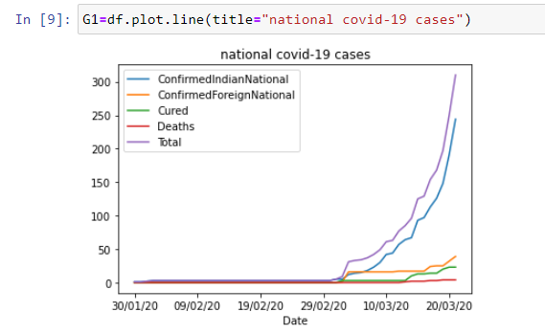
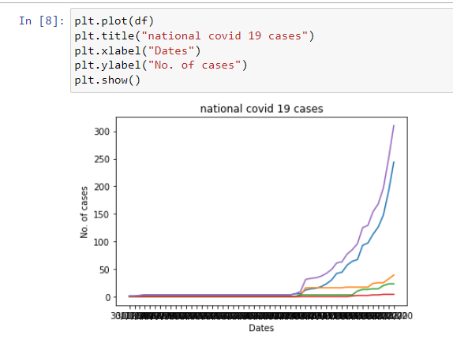
USING DIFF TEACHNIQUE TO GET GRAPH

Slide 17
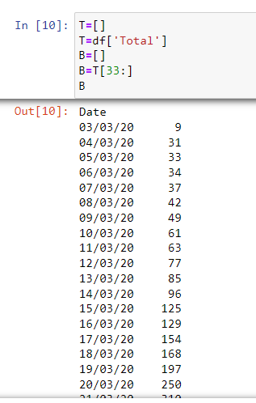
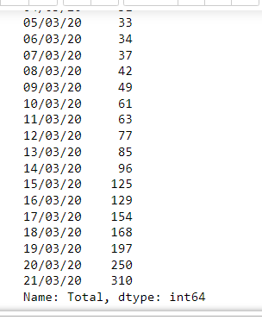
Declaring variable B

Slide 18
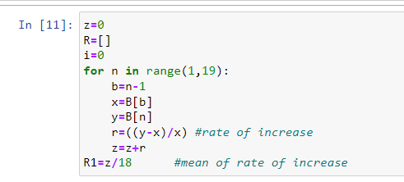
MICRO TASK -4
To check the exponential trend insert the formula
P_t=P_o*(e^(r*t))
r=(# of cases on next day - of cases on current day)/(# of cases on current day)

Slide 19
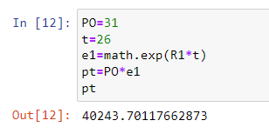
Solving a problem

Slide 20
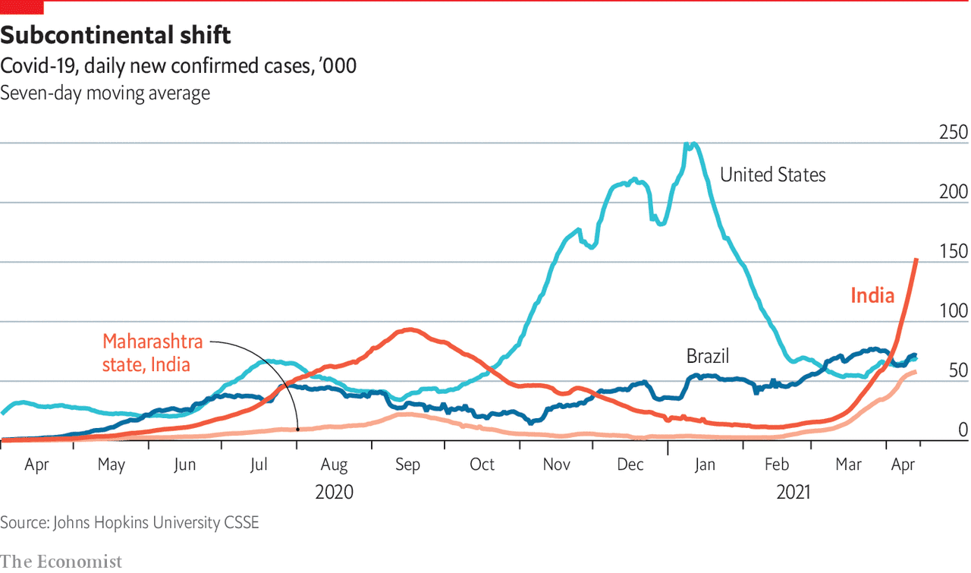
Conclusion
I was able to test successfully the covid analysis
I observed the rapid multiple increase in covid case from 30/01/20 to 21/03/20.

Slide 21

I THANK YOU IEEE team for giving me chance to learn and explore the ML Domain.
Thank’s our Mentor :N Aman Arman Khan
For the great support and motivation

Slide 22

From
AFREEN FATIMA

